Slide 1
Tom & family – Easter @ Moms’ house

Slide 2
Tom, Robb, Allen & The Mov. Atlantic City, Sept. 1982

Slide 3
Ft. Lauderdale, Fl. 1983. silly photos of tom at bedtime

Slide 4
Atlantic City, June 1983

Slide 5
Spring,1986 - Robb’s 1st Fl. home 904 Avocado Isle

Slide 6
Los Angeles forest, L.A. to Las Vegas, Nov. 1986

Slide 7
Nasherrico wins @ Aqueduct, N.Y. 12-27-1986. Tom “jumping Jacks” her to victory

Slide 8
Allen & BethS’ wedding, Florida, August 1987

Slide 9
Outside Robb’s Fl. house, SW 15th Ave., Aug. 1987

Slide 10
Lexington, Kentucky, Sept. 1989. Kenwood wins TOBA Award

Slide 11
Tom 1992

Slide 12
Las Vegas – 1993, Tom & Robb @Excalibur Hotel “The King”

Slide 13
Gulfstream Park, Fl. March 1995

Slide 14
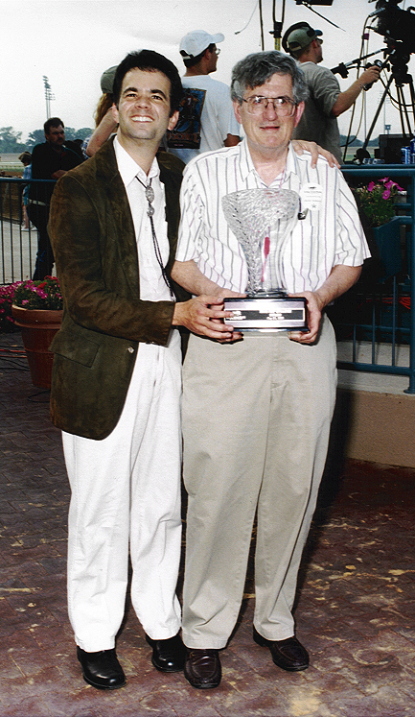
Prime Meridian wins Texas Turf Challenge, Lone Star Park, May 24, 1998

Slide 15
Tom & Diane’s Wedding October 9, 1999 foundry u.m. church Washington, d.c.

Slide 16
Puerto Plata wins Golden Poppy Handicap. Berkeley, Ca. 12-9-2000. Tom crouches to get in photo

Slide 17
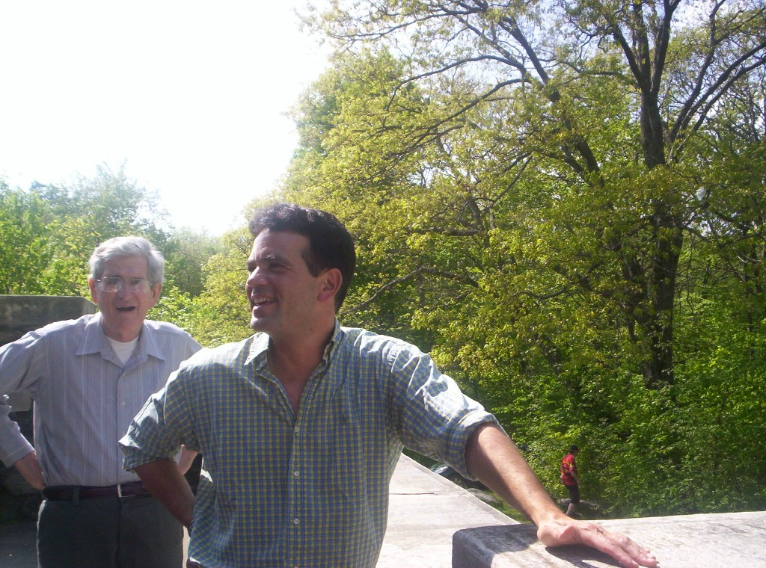
Ian Quinlan’s wedding - May, 2006, Vermont

Slide 18
Skylands Park, N.J. – May 2006

Slide 19
Skylands Park, N.J. – May 2006

Slide 20
Skylands Park, N.J. – May 2006

Slide 21
Grounds for Sculpture, Hamilton, NJ. – June 2007

Slide 22
Grounds for Sculpture, Hamilton, NJ. – June 2007

Slide 23
Grounds for sculpture – September 2007

Slide 24
Grounds for sculpture September 2007

Slide 25
Hallandale, FL – February 2008

Slide 26
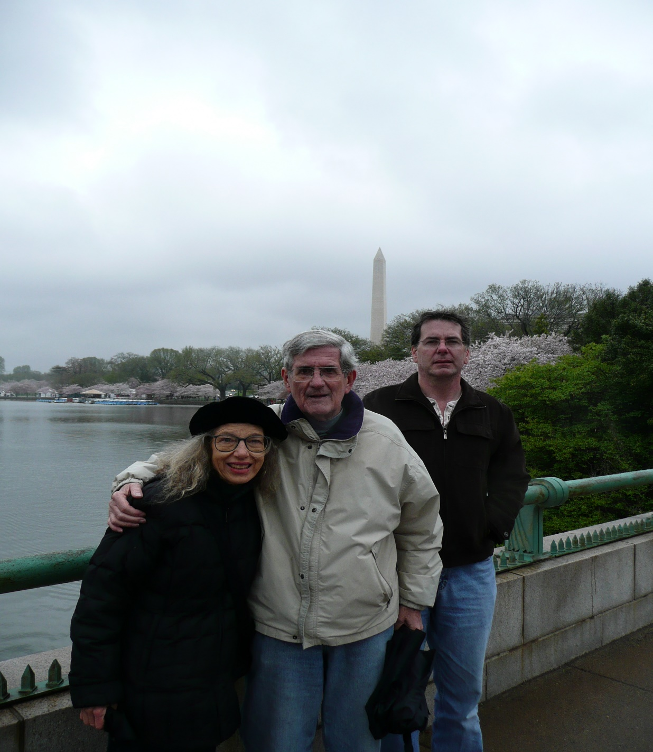
Washington D.C., April, 2008

Slide 27
Monmouth Park, N.J. – July 2009

Slide 28
Monmouth Park – July 2009

Slide 29
Puerto Vallarta, Mexico – New Years 1/1/2010

Slide 30
Puerto Vallarta, Mexico – New Years 1/1/2010

Slide 31
Tom & Diane, Linville falls Circa 2010

Slide 32
Tom & Merriweather @ Wolly worm festival, banner elk, n.c. circa 2010

Slide 33
A night of dancing at Opa Greek Restaurant, Hollywood, Fl. March, 2010

Slide 35
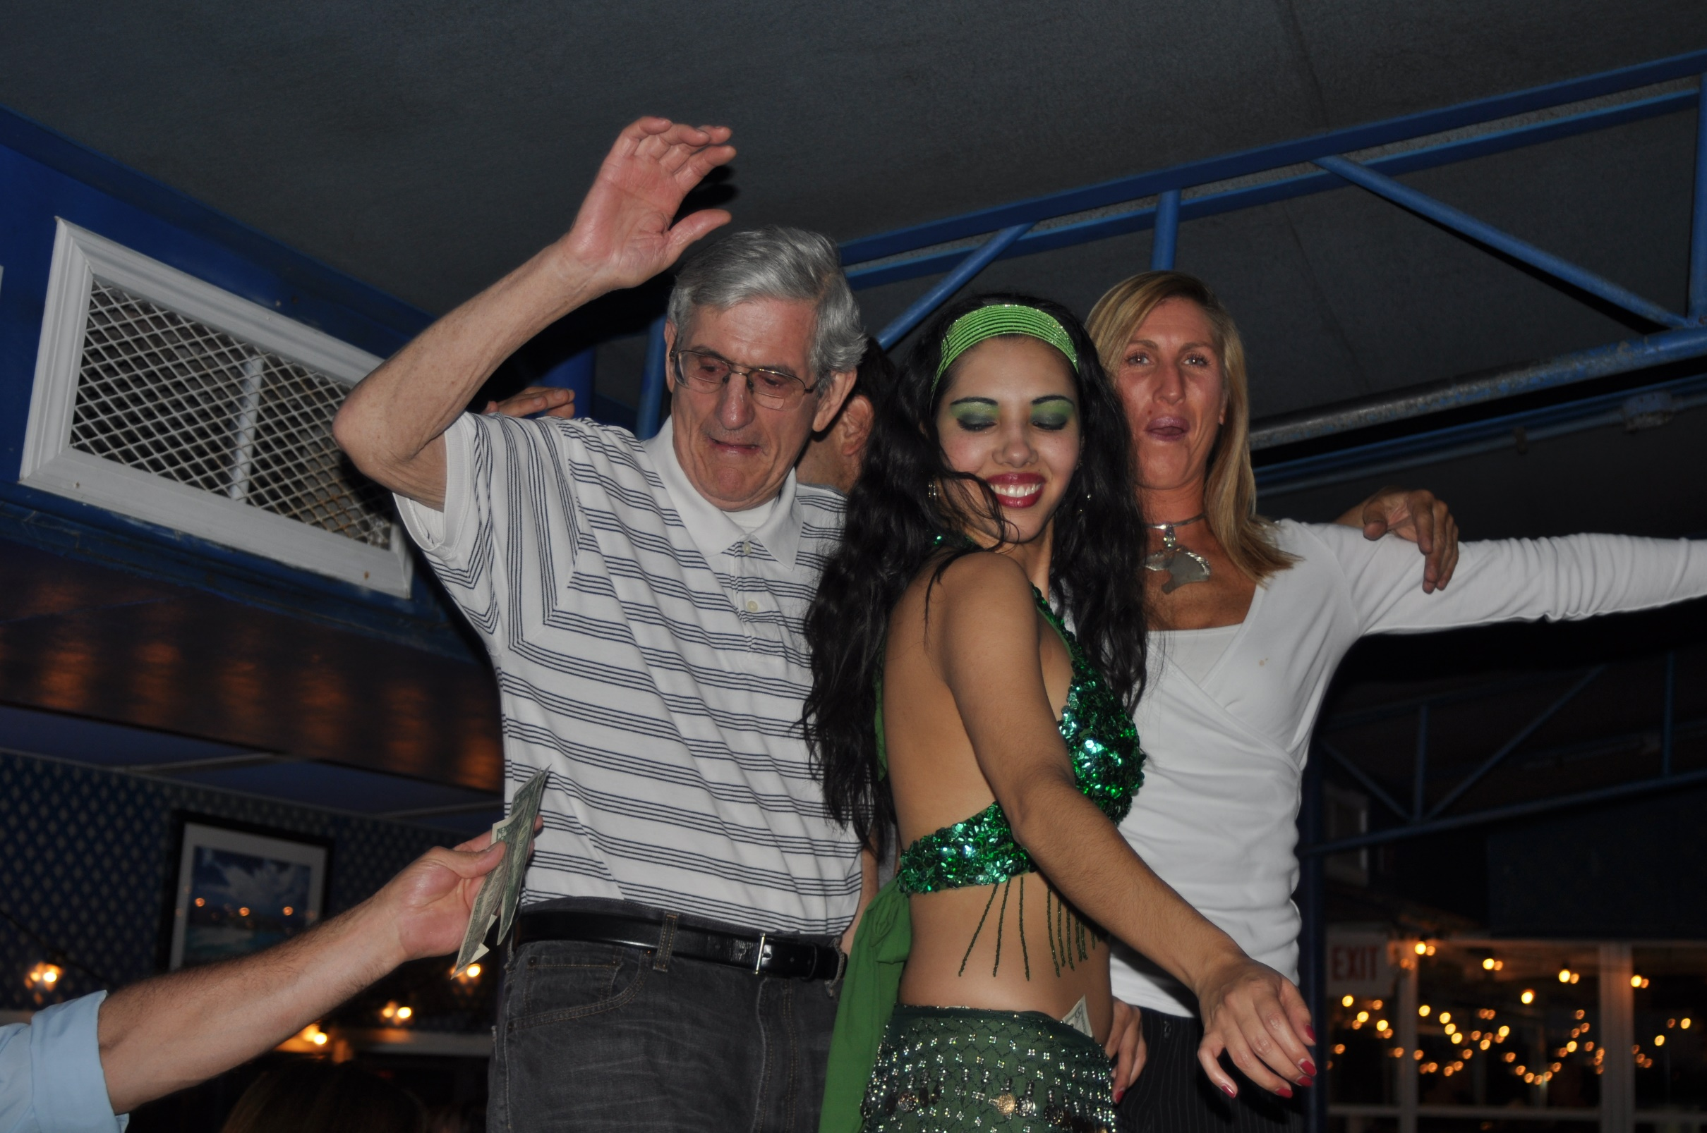

Slide 36
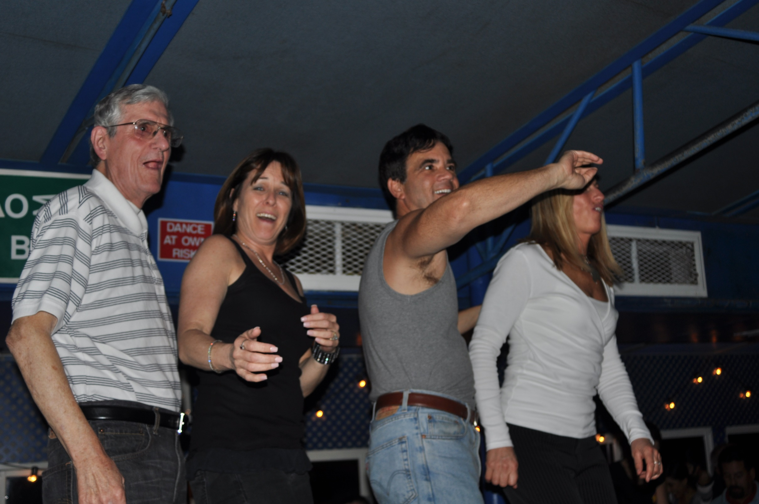

Slide 37
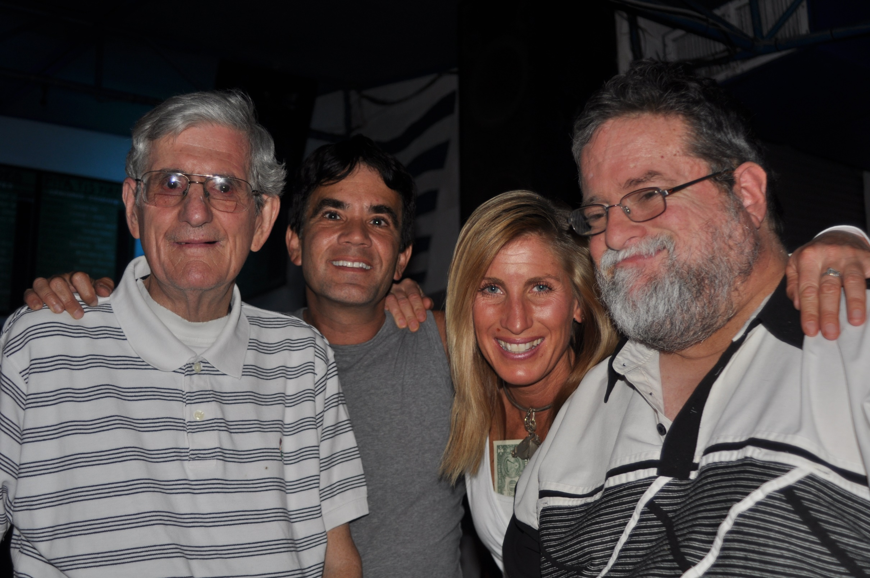

Slide 38
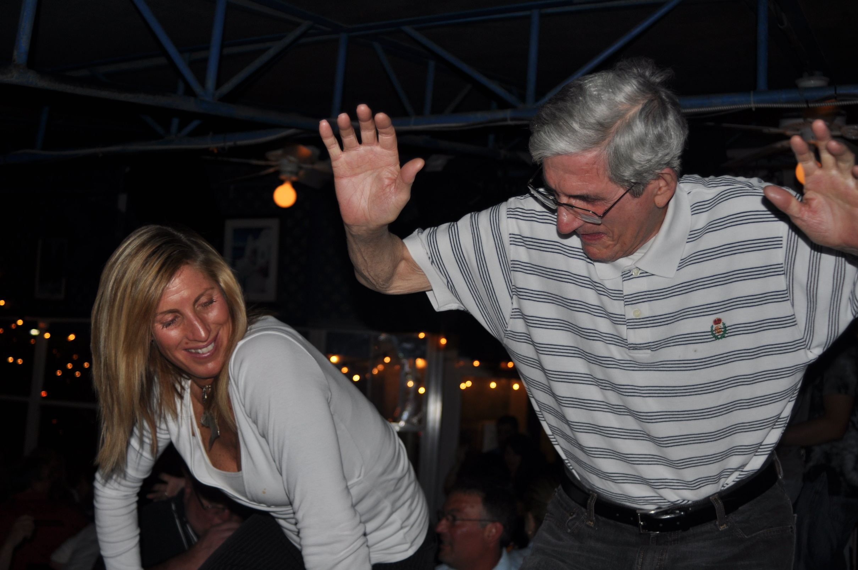

Slide 39
Monmouth Park, N.J Paddock, May 2010

Slide 40
Memorial Day weekend 2010 – Liberty Park, New Jersey

Slide 41
Memorial Day weekend 2010 - NYC

Slide 42
Memorial Day weekend 2010 - NYC

Slide 43
Memorial Day weekend 2010 - NYC

Slide 44
Memorial Day weekend 2010 - NYC

Slide 45
Memorial Day weekend 2010 - NYC

Slide 46
Memorial Day weekend 2010 - NYC

Slide 47
Hermosillo in winner’s circle 2011 Hesse Handicap, Monmouth Park, N.J.

Slide 48
Monmouth Park Parterre Box after Hermosillos’ win in 2011 Hesse Handicap

Slide 49
Accepting Hermosillo’s award as 2011 New Jersey horse of the year

Slide 50
Fuego Mi Amor 2 weeks old at Daydream Farm, March, 2012

Slide 51
Limo outside Belmont Stakes, June 2012

Slide 52
Belmont Stakes, N.Y., June 2012

Slide 53
Haskell weekend July 2012, in front of 705 Grand Ave., Asbury Park, N.J.

Slide 54
Haskell weekend July 2012 – 705 Grand Ave.

Slide 55
Haskell day @Monmouth Park, N.J. - July 2012

Slide 56
Haskell day @ Monmouth July 2012 Great day - Oddly sour faces!

Slide 57
Michael With Us Calder Derby, Miami, Florida April 2013

Slide 58
Winning tickets – Monmouth Park parterre box

Slide 59
Titanium Jo Miss Grillo Stakes, Belmont Park paddock, Oct. 2014

Slide 60
Turf club dining room – Miss Grillo Stakes, Oct. 2014

Slide 61
Fairchild Gardens, Miami Fl. Jan. 2015

Slide 62
Fairchild Gardens, Miami, Fl. Jan 2015
WE’LL REALLY MISS YOU TOM!!!

